Slide 1

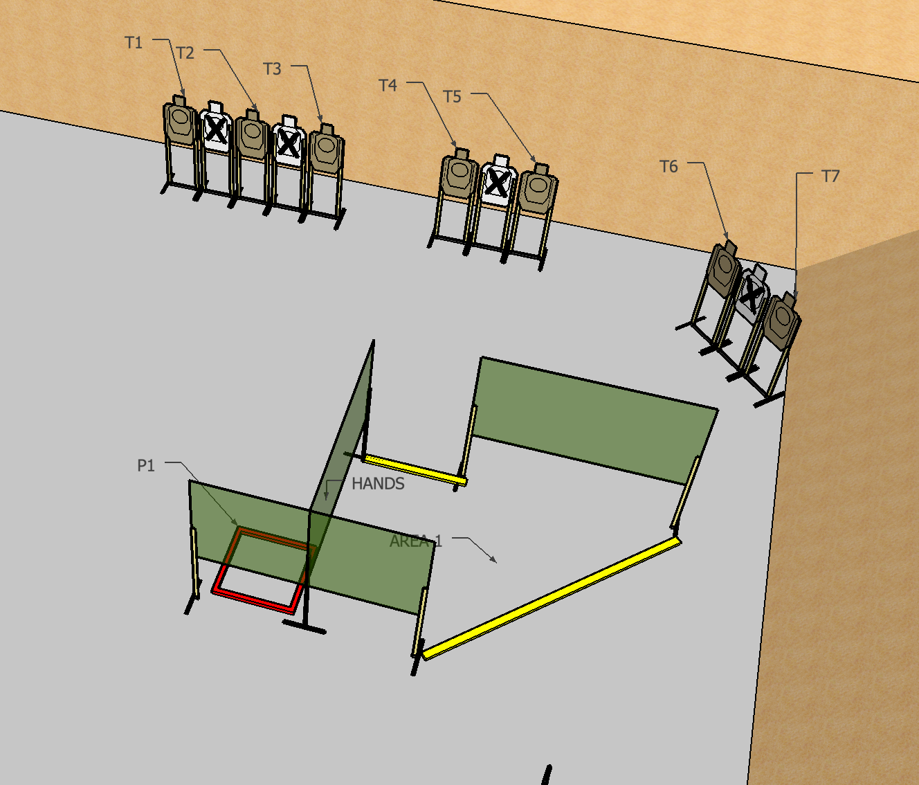
 | Interlake Sporting Association SUR, B Stage: Bad Day At The Park Course Designer: Brian Chinn
START POSITION: Standing in Area 1, hands touching marks. Handgun downloaded to 5 and holstered. PCC downloaded to 5, stock on belt muzzle on lower mark. All magazines downloaded to 5.
STAGE PROCEDURE: At start signal, engage targets from within shooting areas. T1-T3 must ONLY be engaged from P1. |  | STRINGS: 1 SCORING: Comstock SCORED HITS: 2 ROUND COUNT: 14 TARGETS: 7 paper START-STOP: Audible - Last shot Muzzle Safe Points: 180 degree rule

